Slide 1
South Village Historical Walking Tour
Leeanna Ladouceur
Mary Glynn
Melissa Henderson

Slide 2
Background
The late 19th and early 20th centuries was the last great wave of immigration to this country and the largest percentage of people were from Italy.
They usually stayed in distinct neighborhoods of the city.
The South Village, which is a small area of the better-known Greenwich Village, became one of the most significant Italian neighborhoods.
Businessmen emerged as leaders in the community, and developed this small area into a very distinct style of neighborhood.
There was no real plan for the development of the South Village, but the neighborhood was built up with a grand mix of wood and brick storefronts, ornate row houses and brick tenement buildings (Dolkart).
Reference:
Dolkart, Andrew(2006). The South Village: A Proposal for Historic District Designation. Greenwich Village Society for Historic Preservation.
Retrieved from http:// gvshp.org.

Slide 3
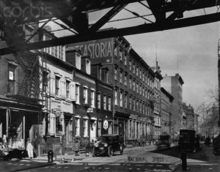
Federal style row houses
Federal style row houses can
be seen all over the South
Village.
Finest examples are on
McDougal street and
Sullivan street.
Details such as columns each
side of door, leaded glass
side windows and window
lintels still exist.
One unusual element seen in
some houses was called a
“horsewalk”.
Reference:
Greenwich Village Society for Historic
Preservation’s Building List. Retrieved from http://gvshp.org.
McDougal Street row houses in 1910

Slide 4
Tenements
South Village settled initially by
Northern Italian Catholics in early
19th century. Southern Italians came
later in the century.
They did not have quality
housing.
Tenement Housing built quickly
and cheaply to house the city’s
poor.
Ornate exterior but dark cold and
cramped interiors.
Reference:
Photo from New York Historical Society. PR 020. Box #44.
White, N. & Willensky, E.(2000). AIA Guide to New York
City(Fourth edition). New York; Three Rivers Press.
Typical Block of tenement buildings

Slide 5
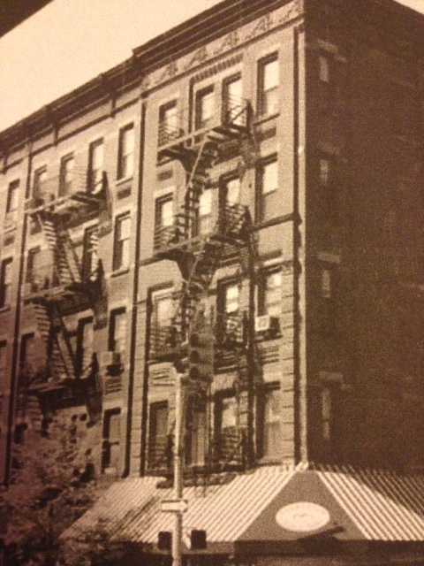
Dominic Abbate
Italian Real estate developer.
Built this building at 173
Bleecker street in 1908.
Built mostly tenements, but
reformed them to give
immigrants better living
conditions.
Considered to be “model
tenement houses”
References:
Gli Italiani Negli Stati Uniti d’America (1906) New York: Italian American Chamber of Commerce.
New York Times(1939). Dominick Abbate,70, a
Realty man, Dies. Retrieved from http://search.
proquest.com/docview/102986865?accountid=
14068.

Slide 6
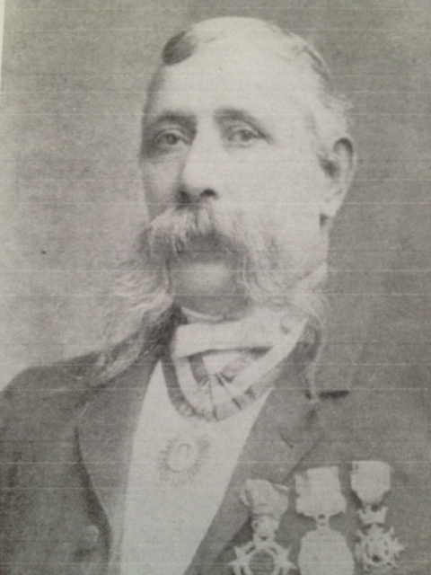
Leaders in community
Luigi Fugazy emerged as a leader in
the South Village.
He was a banker and philanthropist.
Known as padrone or middleman.
Helped fellow Italians sending
money to relatives, getting jobs,
buying steamship tickets.
Poorer immigrants depended
heavily on him.
Reference:
Gli Italiani Negli Stati Uniti d’America.(1906). New York:
Italian American Chamber of Commerce..
New York Times(Aug 10, 1930). Thousands Mourn at Fugazy Funeral. Retrieved from http://search.proquest.com.jerome.stjohns.edu:81/docview/98588111/13D32271EB46ED08F83/1?accountid=14068

Slide 7
Leader of Catholic Italian Community
Father Demo was the Parish Priest of Our Lady of Pompeii from 1897 until 1933.
He provided support for Italian immigrants, not just spiritually.
Their newspaper was the church pulpit.
He kept meticulous records of everyone the church did business with ,and CMS has those records right now.
Reference:
New York Times(1936). Rev. Anthony Demo Dies at age of 65. Retrieved
from http://search.proquest.com/docview/101996331?accountid=14068.
Greenwich Village Society for Historical Preservation. Retrieved from
http//:gvshp.org

Slide 8
Literature Review
Established in 1964.
Promotion of
understanding between
immigrants and receiving
communities.
Building filled with
archived documents and
photographs.
Our emphasis was on
invoices associated
with church.
These records kept by
Father Demo.
Reference:
Center for Migration Studies. New York. Collection # 037
Gli Italiani Negli Stati Uniti d’America (1906) New York: Italian American Chamber of Commerce

Slide 9
Greenwich Village Society for Historical Preservation proposal to landmark South Village Area
Many areas of Greenwich
Village landmarked.
South Village still does
not have landmark
designation.
First proposal for
land marking submitted in
2006.
Buildings on Streets such
as Carmine, Bleecker,
Thompson, Sullivan,
and Minetta in imminent
danger.
Reference:
Greenwich Village Society for Historical Preservation.
Retrieved from http//:gvshp.org

Slide 10
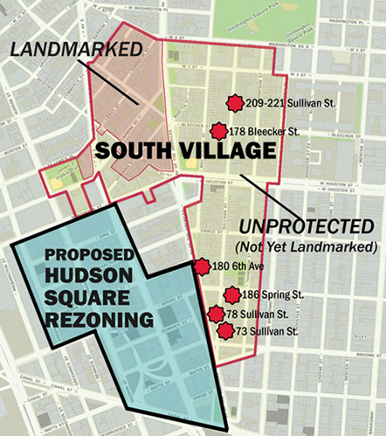
Our Goals
GVSHP wants South Village landmarked before the decision is made to rezone Hudson Square.
GVSHP have a wonderful walking tour of area on their website, but it shows modern day architecture.
Using historical photographs of buildings in this area, and Google maps, we created a historical walking tour of neighborhood.
Reference:
Greenwich Village Society for Historic Preservation. Retrieved from
http//:gvshp.org

Slide 11
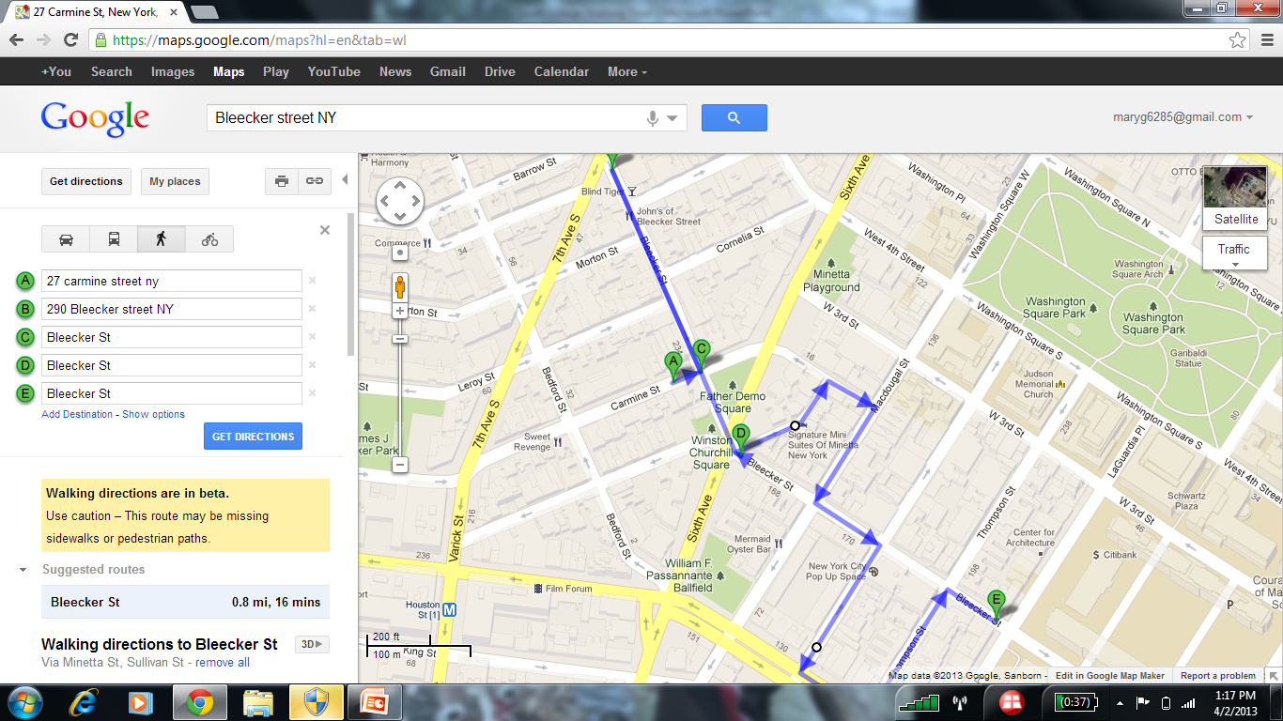
Link: http://goo.gl/maps/jXQyo.

Slide 12
Literature Review
The book Gli Italiana negli Stati Uniti d’America was created with the soul purpose
of showing off how successful Italian people were in America. This book details the
lives of Italian businessmen such as Domenic Abbate and Luigi Fugazy.
The Greenwich Village Society for Historical Preservation have worked tirelessly to
try and get the South Village landmarked. Their website is a wealth of information
has all of their documentation .
Two papers written by Mary Brown from CMS discusses the lives of Italian
immigrants, and the development of the South Village.
A book called Greenwich Village And How It Got That Way written by Terry Miller
has valuable information about the importance of street fairs, food venues, and coffee
houses in the development of this area.
References:
Brown, M. (2007) The Italians of the South Village. New York. Greenwich Village Society for Historic Preservation.
Brown, M. (1992). From Italian Villages to Greenwich Village. New York: Center for Migration Studies.
Gli Italiani Negli Stati d’America.(1906). New York: Italian American Chamber of Commerce. Translated by Prof. Scala. Saint Johns University.
Greenwich Village Society for Historic Preservation. Retrieved from http://gvshp.org.
Miller, T.(1990). Greenwich Village and How It Got That Way. New York: Crown Publishers.

Slide 13
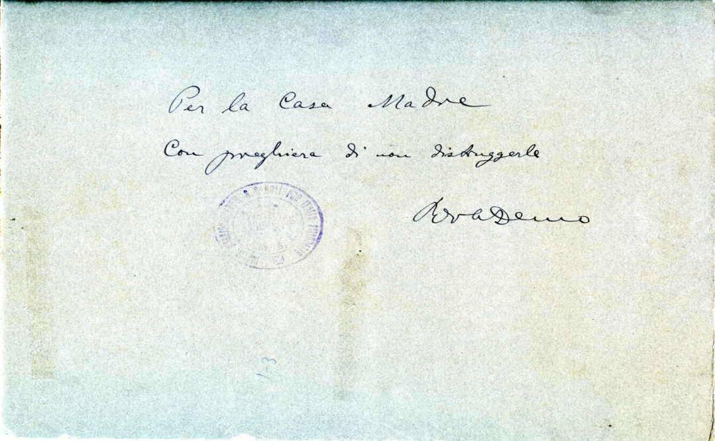
Front
Title: Our Lady of Pompeii Church
Subject: Greenwich Village, New York City, Italian, Catholic Church, Immigration
Description: Our Lady of Pompeii Church is located on Bleecker street in Greenwich Village.
Publisher: Center of Migration Studies
Date:
Type: Photographic Print
Format: JPEG
Source: Our Lady of Pompeii
Language: Italian
Coverage: North America, United States, New York State, New York City, Greenwich Village, Bleecker Street, Carmine Street
Rights Holder: Center for Migration Studies
Back

Slide 14
Bleecker street
This is Bleecker street in 1926. The building on the left is the old Our Lady of Pompeii church.
The new church spire can be seen behind the lamp post.
All of the buildings in the foreground are slated for demolition because of the extension of sixth avenue and the subway line.
References:
Photograph from New York Public Library.
Image ID: 716693f Irma and Paul Millstein Division

Slide 15
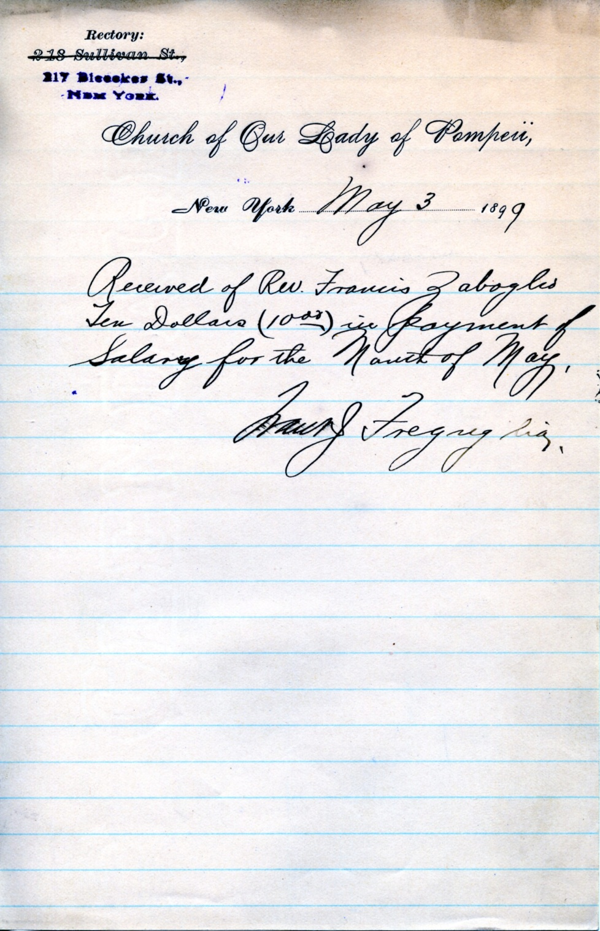
Title: Our Lady of Pompeii Receipt of Payment
Creator: Our Lady of Pompeii
Subject: Receipt, Our Lady of Pompeii, Greenwich Village, Italian, Immigration, Catholic Church
Description: A receipt of salary payment dated May 3, 1899 from Our Lady of Pompeii Church located on Bleecker Street.
Publisher: Center for Migration Studies
Contributor: N/A
Date: May 3, 1899
Type: Photographic Print
Format: JPEG
Identifier: N/A
Source: Our Lady Of Pompeii
Language: English
Relation: N/A
Coverage: North America, United States, New York State, New York City, Greenwich Village, Bleecker Street
Rights Holder: Center for Migration Studies

Slide 16
Birth of current Our Lady of Pompeii Church
This is a photograph taken in 1926 of 27-29 Carmine street just as construction was starting on Our Lady of Pompeii church.
Reference:
Image ID 718109f from New York Public Library. Irma and
Paul Milstein Division.

Slide 17
Our Lady of Pompeii Church
Reference:
Photograph from New York Public Library. Percy Loomis Sperr collection. Image ID: 718107f

Slide 18
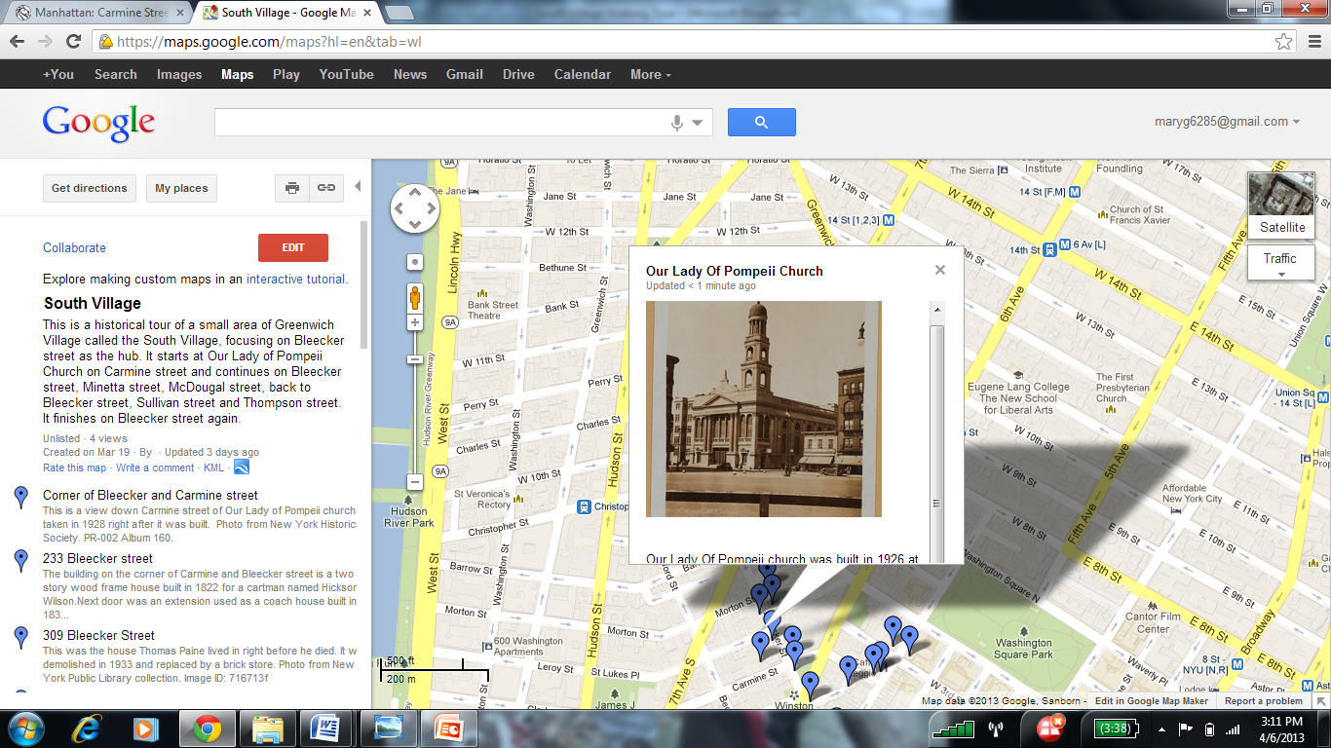

Slide 19
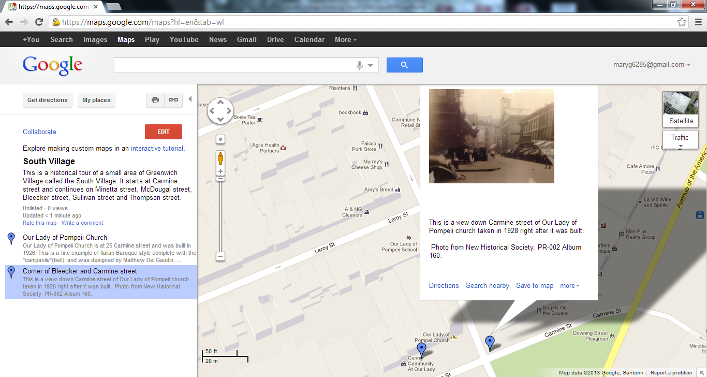

Slide 20
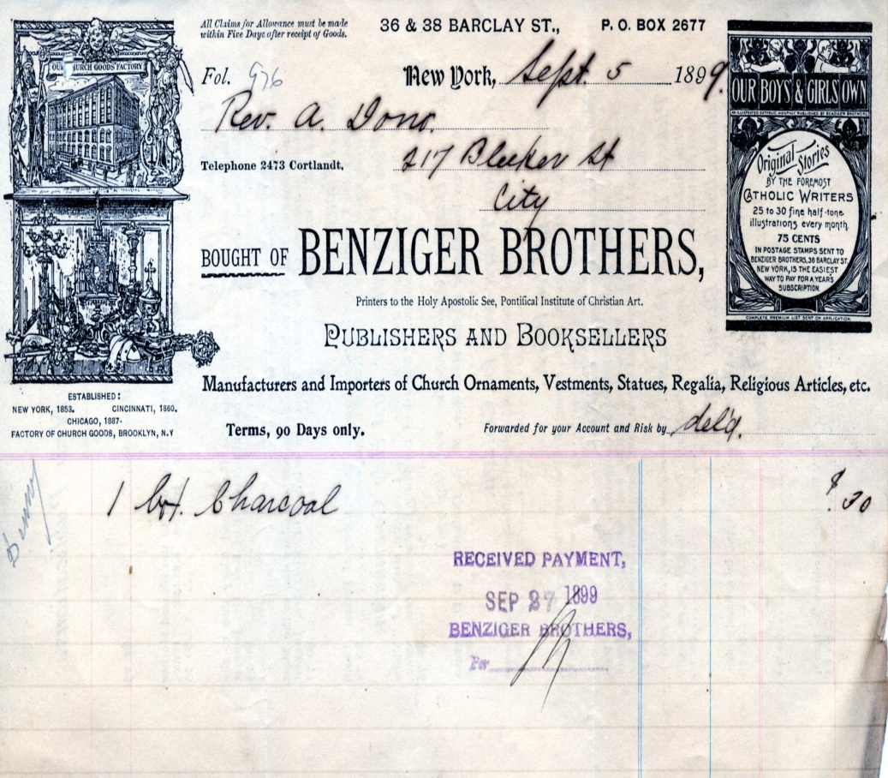
Title: Benziger Brothers Invoice
Creator: Benziger Brothers
Subject: Invoice, Greenwich Village, Business, Italian, Publishers, Booksellers, Church Description: An invoice from 1899 from Benziger Brothers located on Barclay Street in Greenwich Village
Publisher: Center for Migration Studies
Contributor: N/A
Date: September 5, 1899
Type: Photographic Print
Format: JPEG
Identifier: N/A
Source: Our Lady of Pompeii
Language: English and Italian
Relation: N/A
Coverage: North America, United States, New York State, New York City, Greenwich Village, Barclay Street
Rights Holder: Center for Migration Studies

Slide 21
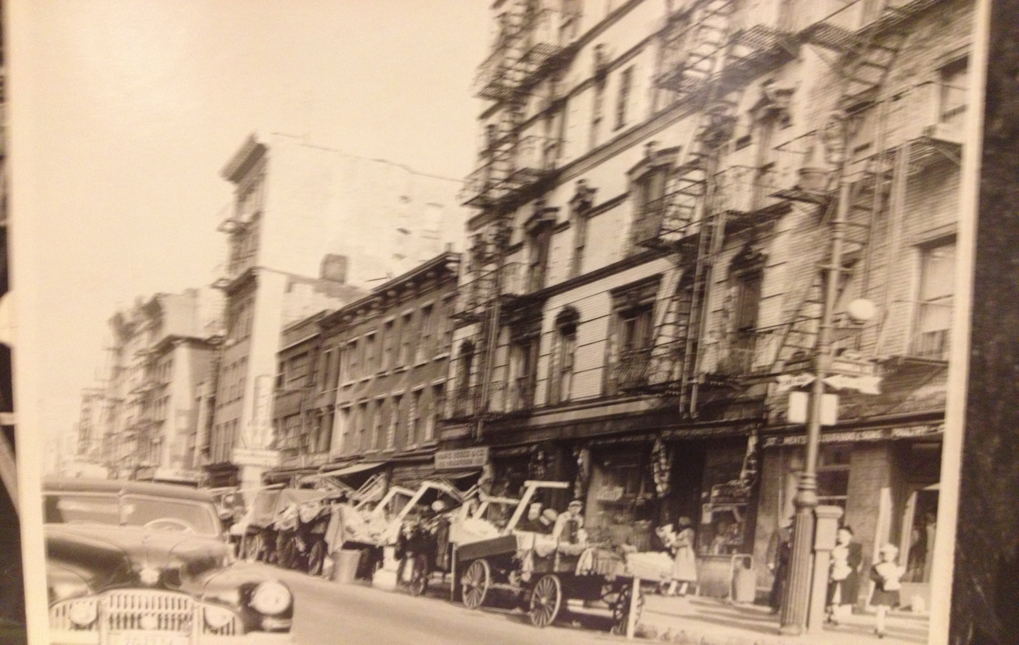
257 Bleecker street(Dorando Meats) is now for sale and boarded up.
Reference:
Photo from New York Historical Society. PR 020. Negative #70122

Slide 22
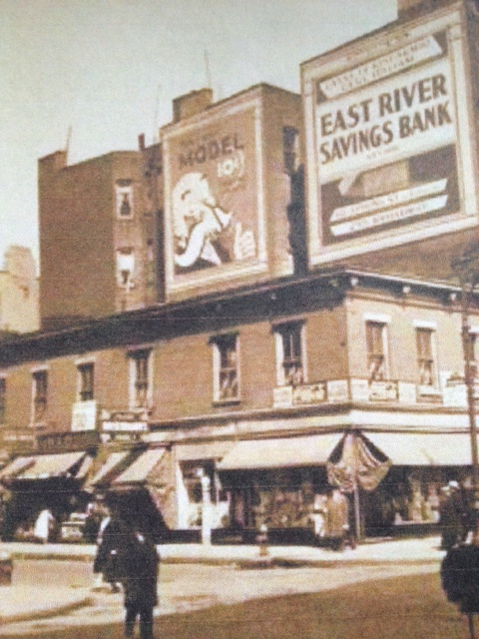
231 Bleecker street.
Built in 1822.
Two of the few wood
frame houses left in
Manhattan.
Wood covered with
siding but details at top
and windows still intact.
Reference:
Photo from New York Public Library. Percy Loomis Sperr Collection.

Slide 23
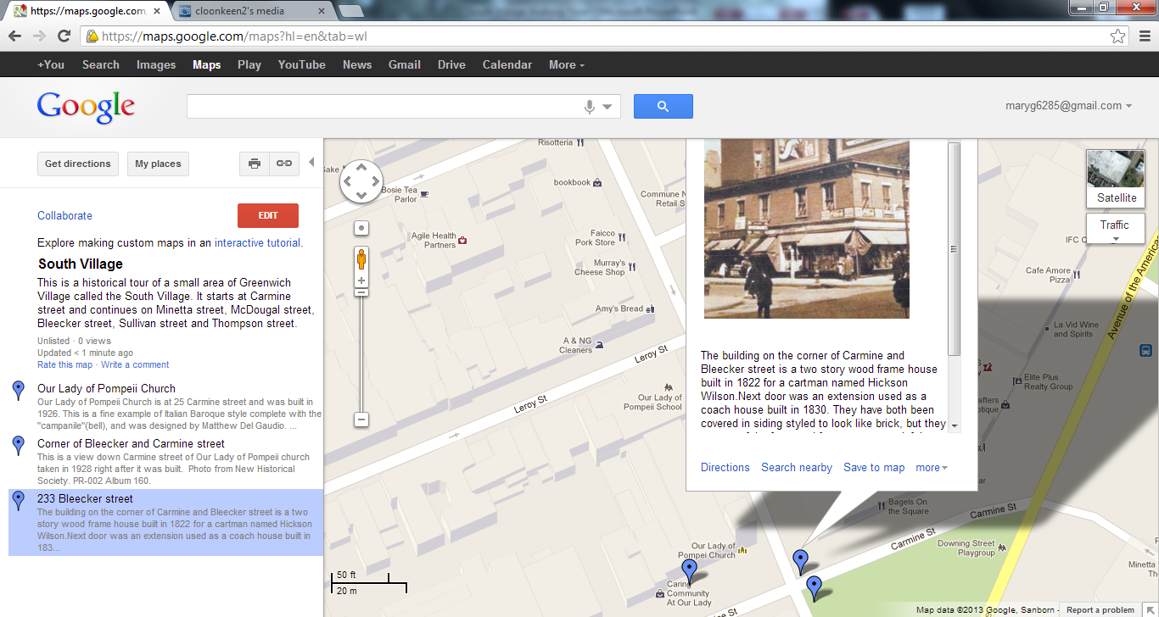

Slide 24
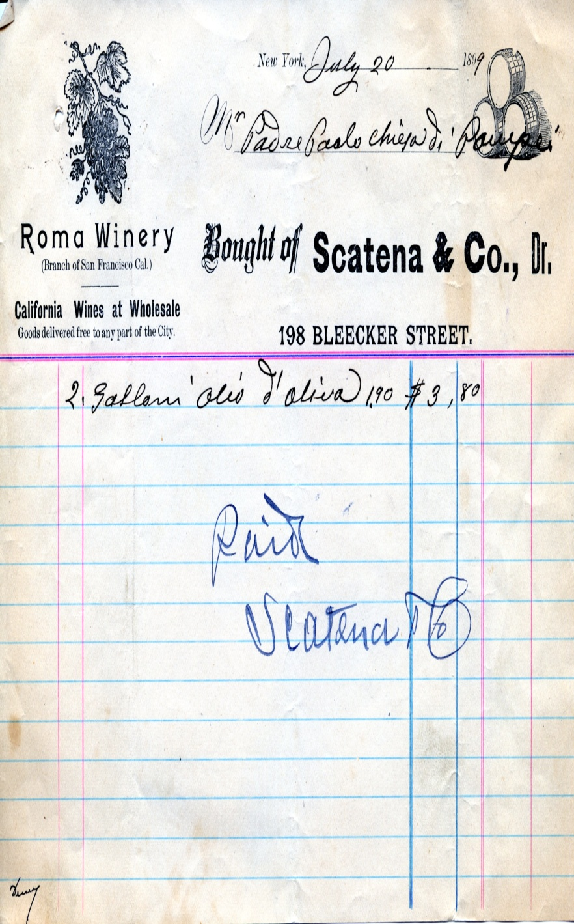
Title: Scatena & Co. Invoice
Creator: Scatena & Co.
Subject: Greenwich Village, Italian, Business, Invoice, Winery Description: An invoice from Scatena & Co. dated in 1899 located on 198 Bleecker Street
Publisher: Center for Migration Studies
Contributor: N/A
Date: July 20, 1899
Type: Photographic Print
Format: JPEG
Identifier: N/A
Source: Our Lady of Pompeii
Language: English and Italian
Relation: N/A
Coverage: North America, United States, New York State, New York City, Greenwich Village, Bleecker Street
Rights Holder: Center for Migration Studies

Slide 25
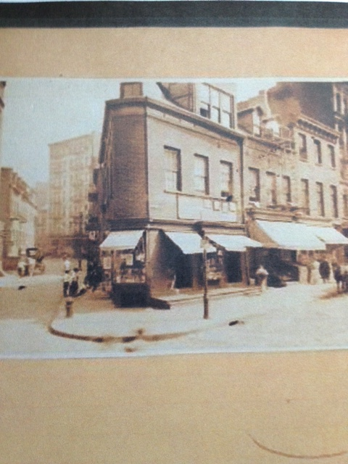
Corner of Minetta & Bleecker
198 Bleecker directly across
street.
Photographed in 1922.
Building still there with details,
but floors have been added.
Reference:
Photograph from New York Public Library, Irma and Paul
Milstein Division. Image ID: 716689f

Slide 26
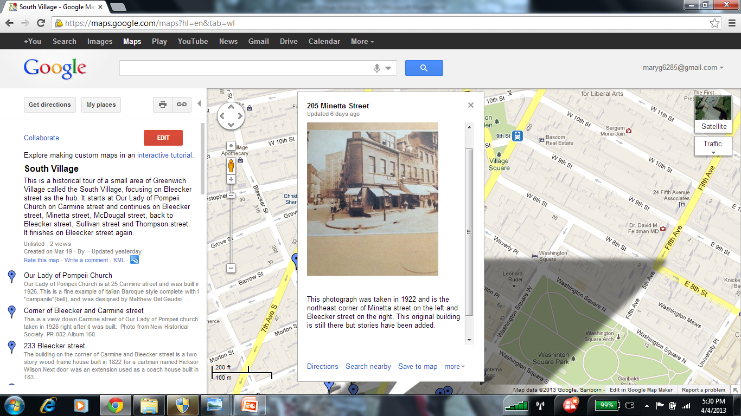

Slide 27
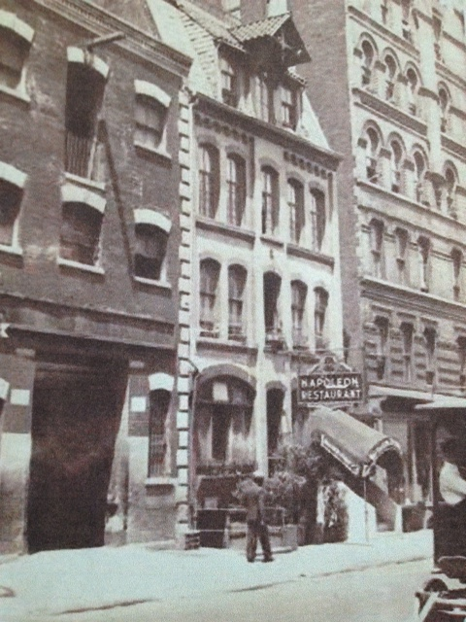
115 – 117 MacDougal street.
Built in 1907.
115 was a stable with hay loft
at top of building.
Still intact but not landmarked.
115 is now the Players Theater.
Reference:
Greenwich Village Society for Historical Preservation,
Building List. Retrieved from http://gvshp.org

Slide 28
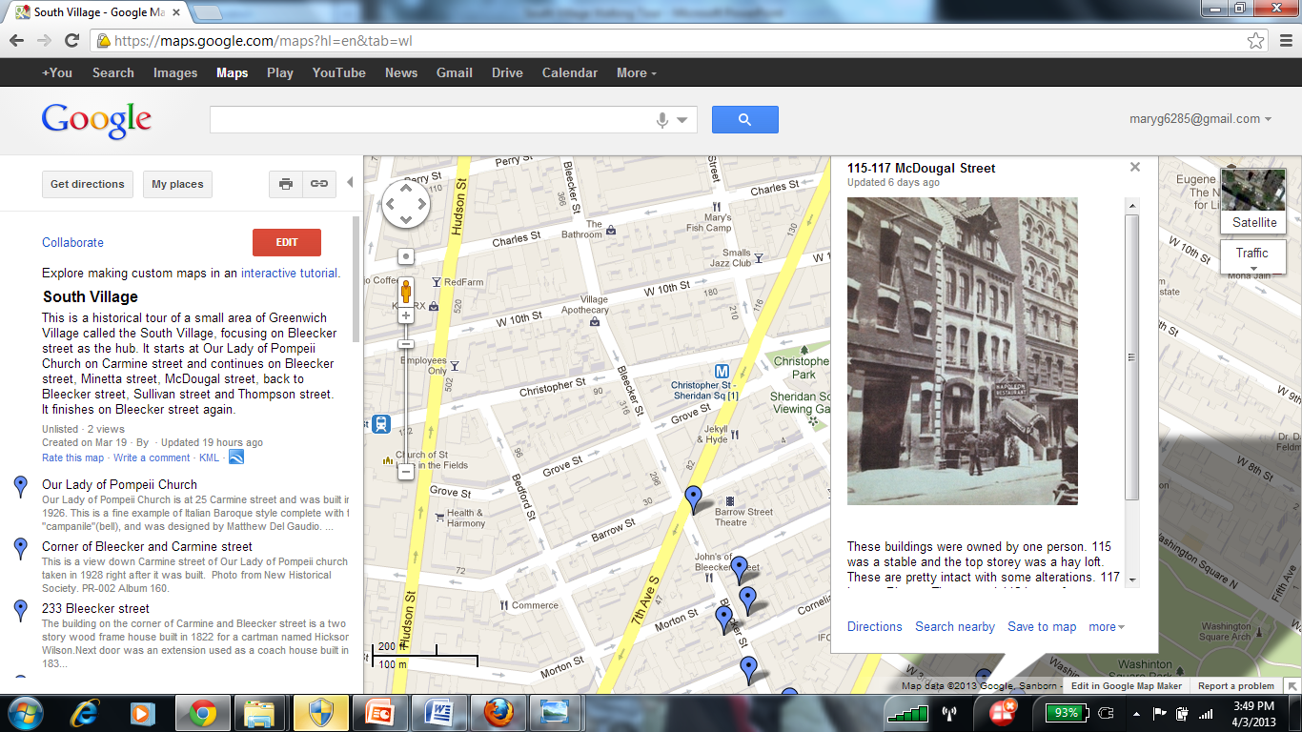

Slide 29
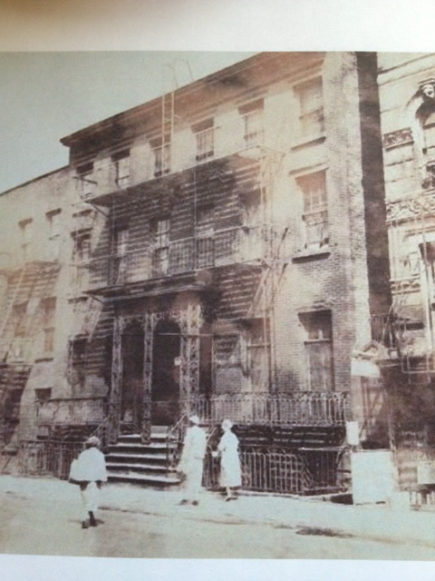
130-132 MacDougal st.
Built in 1852.
Greek Revival style.
Louisa May Alcott lived
here.
Still completely intact.
Reference:
Photograph from New York Public Library.
Percy Loomis Sperr collection. Image ID:
721163f.

Slide 30
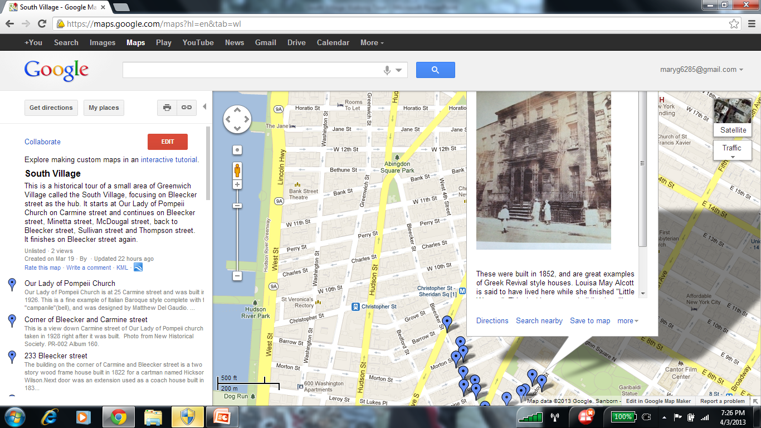

Slide 31
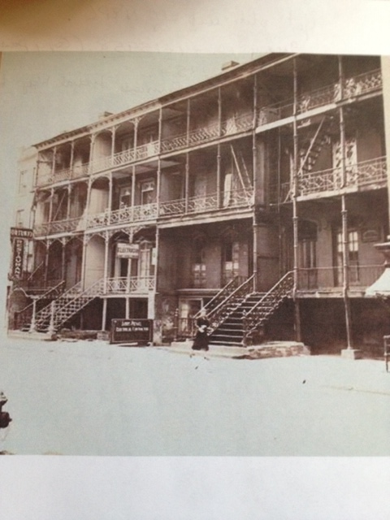
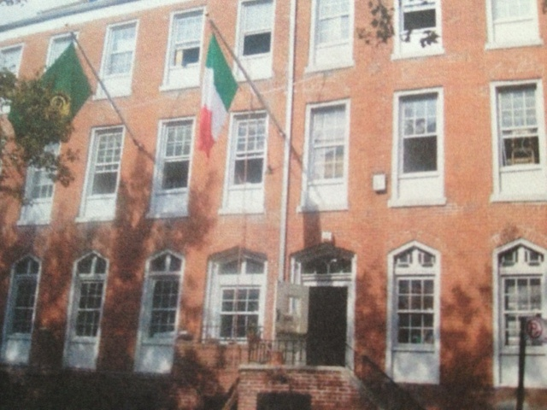
71-77 MacDougal Street in 1933 Today
Tiro A Segno headquarters in 1922
Reference:
Photograph from New York Public Library. Percy Loomis Sperr collection. Image ID: 721158f .
New York Times(May 7, 1922). Quaint Old Houses on MacaDougal Street to be Adapted foe Modern Living Needs.
Greenwich Village Society for Historical Preservation. Retrieved from http://gvshp.org

Slide 32
Literature Review
We used various articles from newspapers from the early 1900’s to help us to gather
information about the various businesses in the South Village.
These articles honored the lives of Father Demo, Luigi Fugazy and Dominic
Abbate, and Placido Mori.
The AIA guide to New York City has valuable information about the buildings in the
South Village, and supports the documentation from the Greenwich Village Society
for Historic Preservation.
Our photographs were obtained from New York Historical Society and the New
York Library.
Reference:
New York Public Library Digital Collections. New York.
New York Historical Society archives. New York
New York Times(1927). Placido Mori Dead . Retrieved from http://search.proquest.com.jerome.stjohns.edu:81/docview/104127216/13D423B9B2830FEACBC/1?accountid=14068.
New York Times(1930) Thousands Mourn at Fugazy Funeral. Retrieved from
http://search.proquest.com/docview/98588111?accountid = 14068.
New York Times(1930). Dominick Abbate,70, a Realty Man , Dies. Retrieved from http://search.proquest.com/docview/102986865? Accountid = 14068.
White, N. & Willensky, E.(2000). AIA Guide to New York City. New York City: Three Rivers Press.

Slide 33
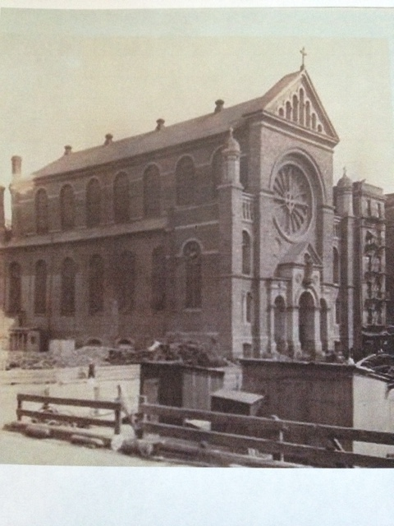
Saint Anthony of Padua Catholic
church. 154 Sullivan street.
Built in 1866.
Romanesque style.
Oldest remaining Italian church
in the Americas.
Still in original condition.
Reference:
Brown, M.(2007) The Italians of the South Village. New York
Greenwich Village Society for Historical Preservation.
Photograph from New York Public Library. Image ID :
723466f

Slide 34
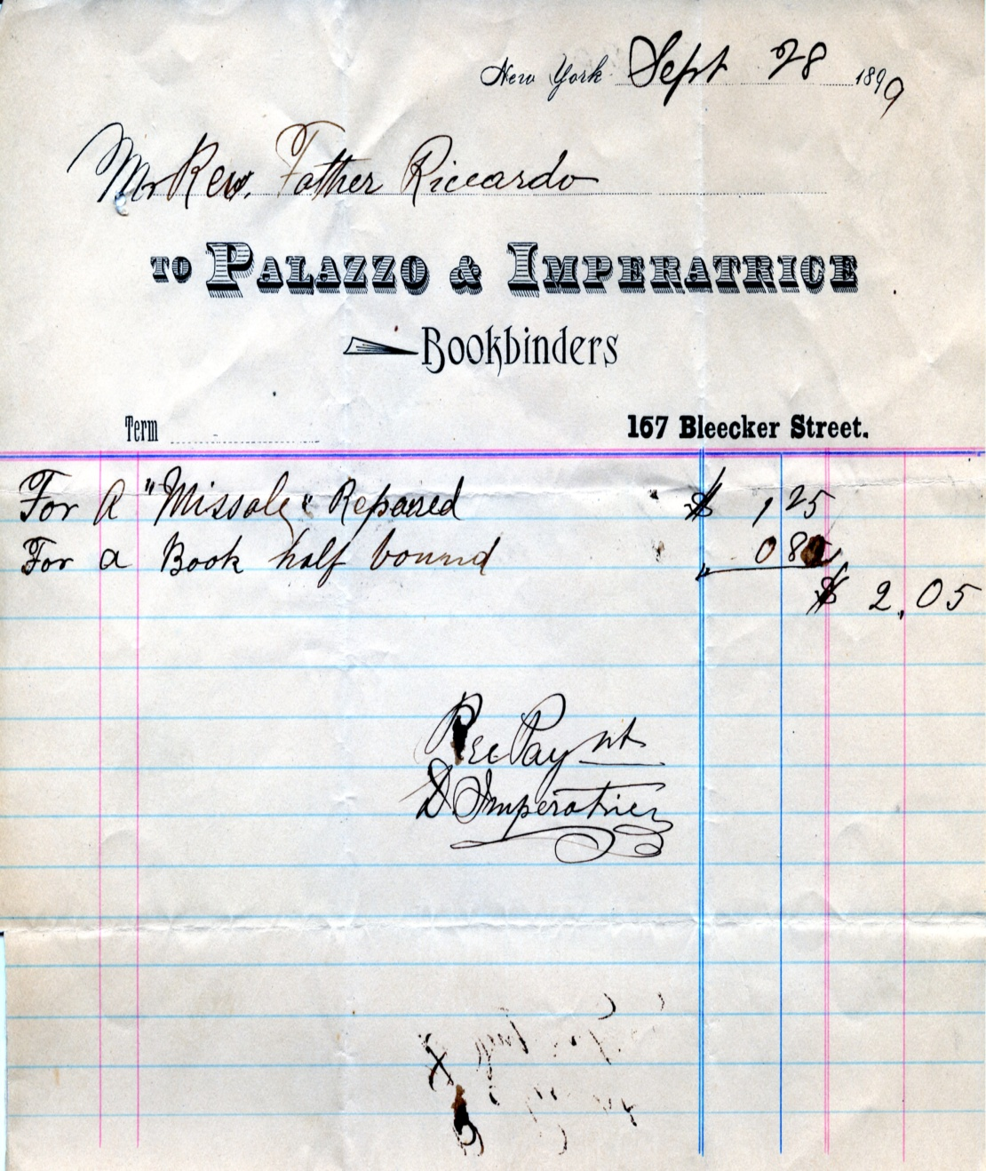
Title: Palazzo & Imperatrice Bookbinders Invoice
Creator:Palazzo & Imperatrice Bookbinders
Subject: Greenwich Village, Italian, Bookbinder, Business, Invoice Description: An invoice dated from 1899 from a bookbinders located on Bleecker Street
Publisher: Center for Migration Studies
Contributor: N/A
Date: September 28, 1899
Type: Photographic Print
Format: JPEG
Identifier: N/A
Source: Our lady of Pompeii
Language: English and Italian
Relation: N/A
Coverage: North America, United States, New York State, New York City, Greenwich Village, Bleecker Street
Rights Holder: Center for Migration Studies

Slide 35
160 Bleecker Street Transformation
Depau Row in 1826 Mills House No. 1 in 1905

Slide 36
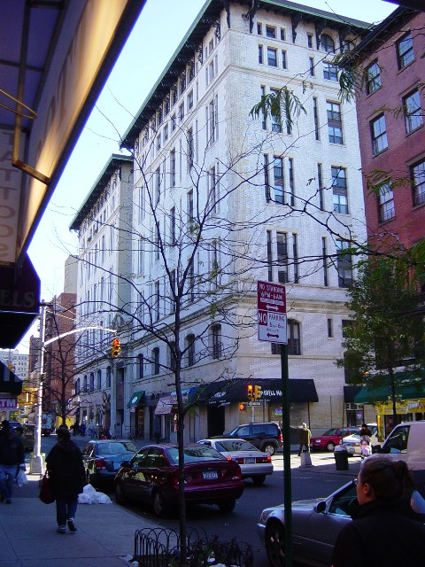
Today, this building is high end
condominiums.
Called The Atrium.
Original building details kept
intact.
Still not a landmarked building.
Reference:
Greenwich Village Society for Historical Preservation.. Retrieved from http//:gvshp.org

Slide 37
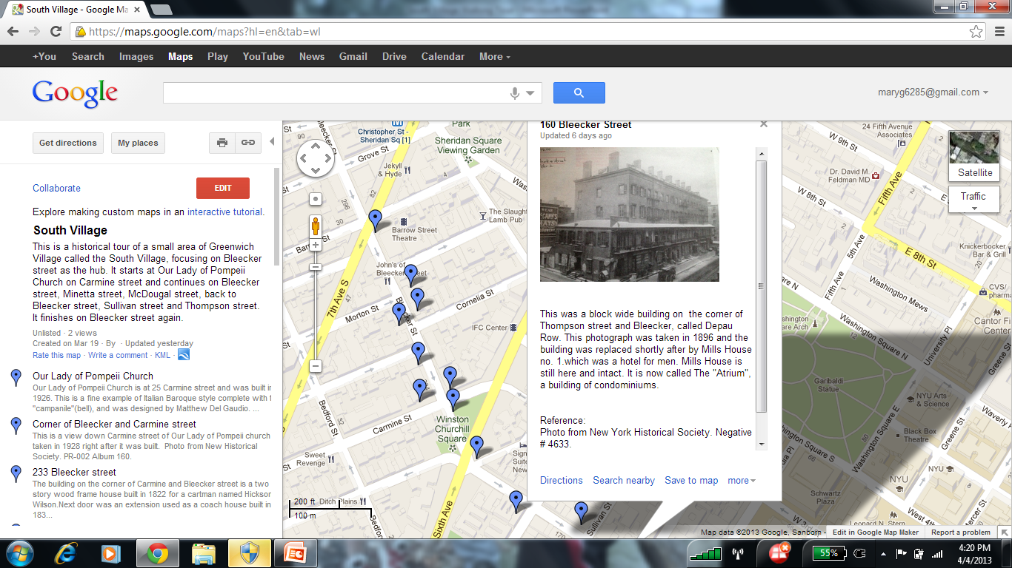

Slide 38
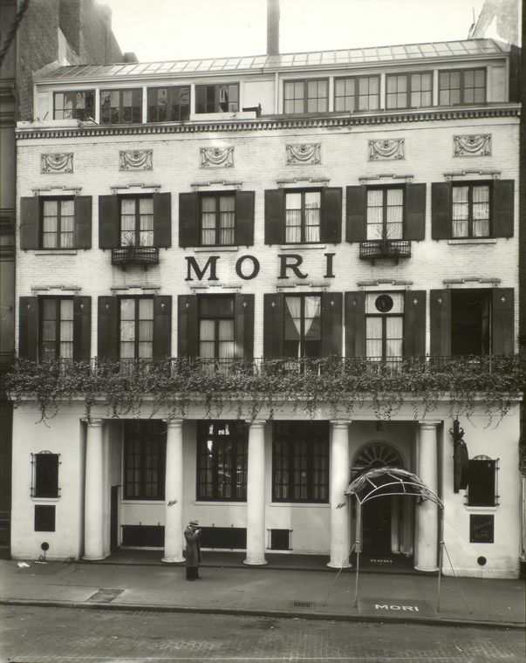
Mori’s restaurant. 144
Bleecker street.
Originally a pair of federal
row houses.
In 1883, Placido Mori
opened restaurant.
In 1920, the columns were
added and the wall plaques.
Restaurant closed in 1938.
Building still intact.
Reference:
Miller, T.(1990). Greenwich Village and How it Got That Way. New York: Crown Publishers Inc.
New York Times(1927). Placido Mori Dead .
Retrieved from http://search.proquest.com.jerome.stjohns.edu:81/docview/104127216/13D423B9B2830FEACBC/1?accountid=14068.
Photograph from New York Public Library. Bernice
Abbott collection. Image ID: 482851

Slide 39
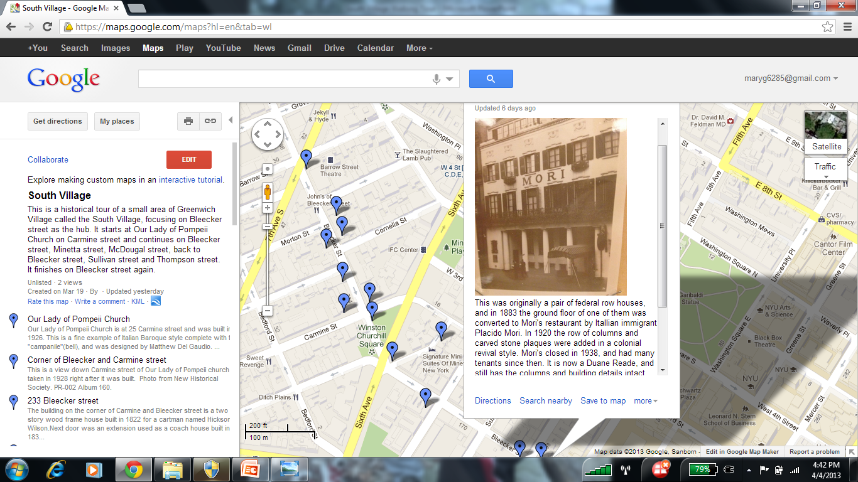

Slide 40
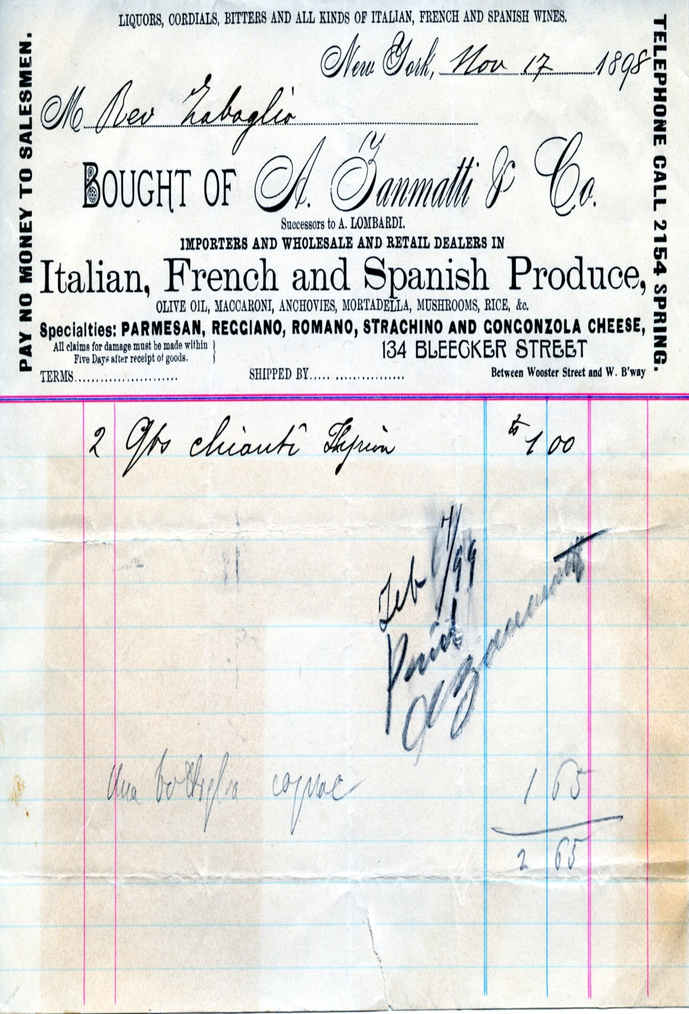
Title: Invoice of A. Zanmatti & Co.
Creator: A. Zanmatti & Co.
Subject: Italian, Greenwich Village, Business, Invoice
Description: An invoice dated from 1898 detailing an order; located on 134 Bleecker Street.
Publisher: Center for Migration Studies
Date: November 17, 1898
Type: Photographic Print
Format: JPEG
Source: Our Lady of Pompeii
Language: English and Italian
Relation: N/A
Coverage: North America, United States, New York State, New York City, Greenwich Village, Bleecker Street
Rights Holder: Center for Migration Studies

Slide 41
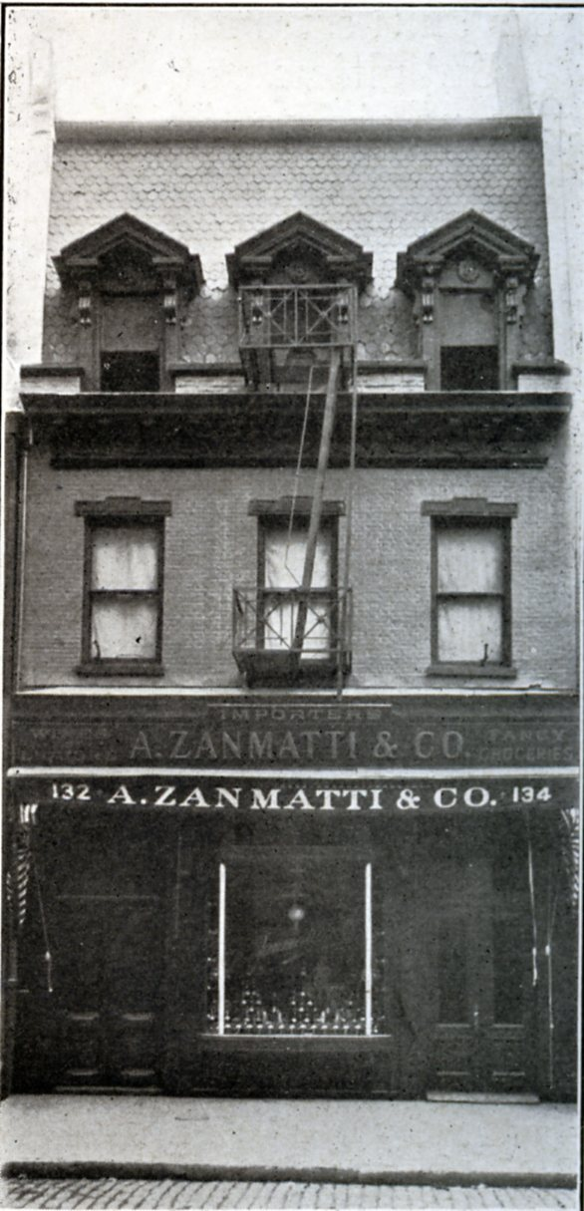
Zanmatti & Co. 134 Bleecker street.
European Food Importers.
Building demolished.
Almost everything around here
demolished in the 1960’s , to make
way for construction of Silver
Towers and Washington Square
Village.
All high rise buildings now.
Reference:
Gli Italiani Negli Stati Uniti d’America. (1906). New York: Italian
American Chamber of Commerce.

Slide 42
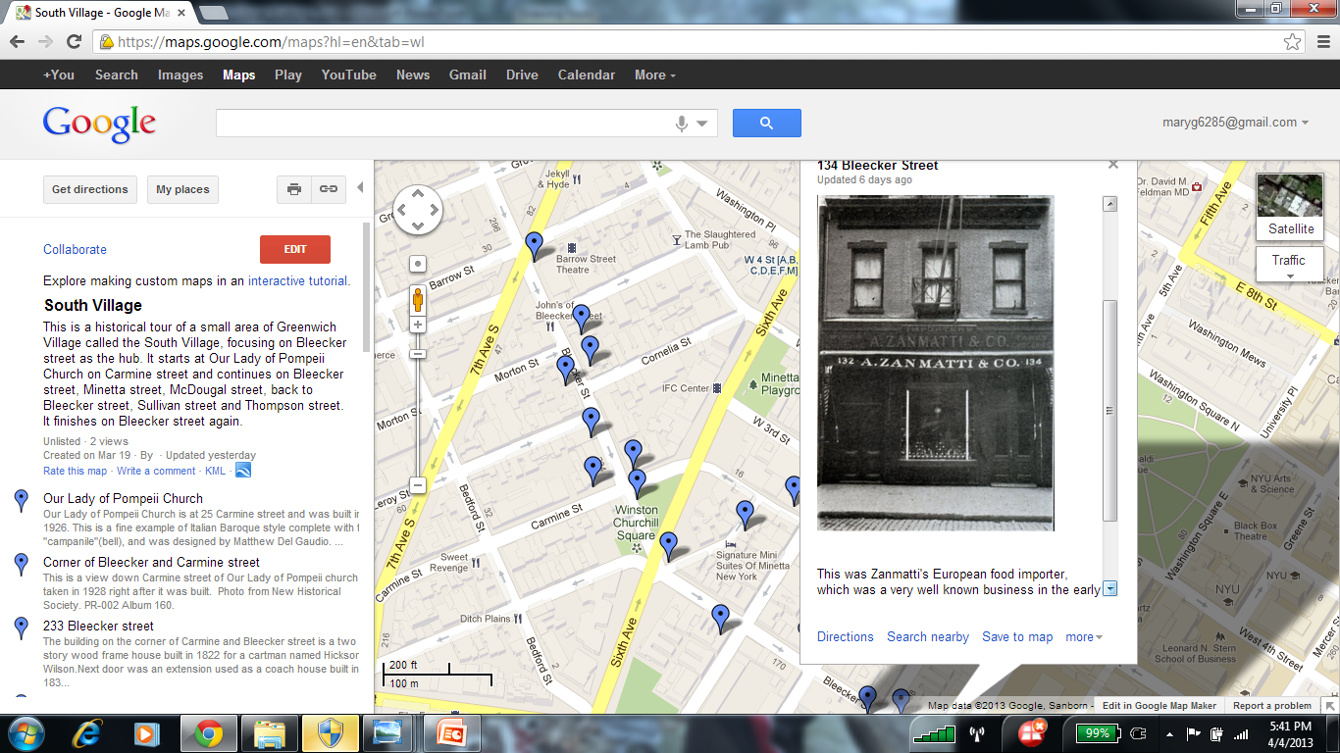

Slide 43
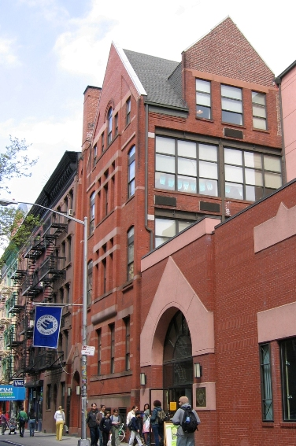
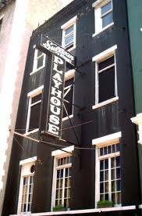
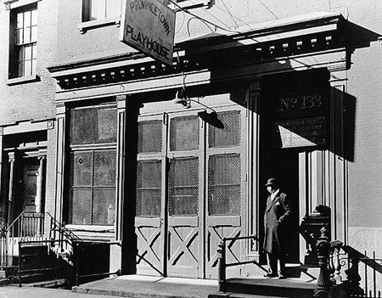
Buildings Demolished since 2006
Sullivan street Playhouse built in 1831. Demolished in 2005.
The Childrens Aid Society building was built in 1891 and sold in 2011. Serious danger of being demolished.
Provincetown Playhouse
demolished in 2009
Link: http://goo.gl/maps/jXQyo.
Reference:
Greenwich Village Society for Historic Preservation. Retrieved from http://gvshp.org.
Photograph from the Museum of the City of New York.

